Slide 1
Distributed Pharmaceutical Supply Management Using Hyperledger Fabric
Travis Nilest
CS395

Slide 2
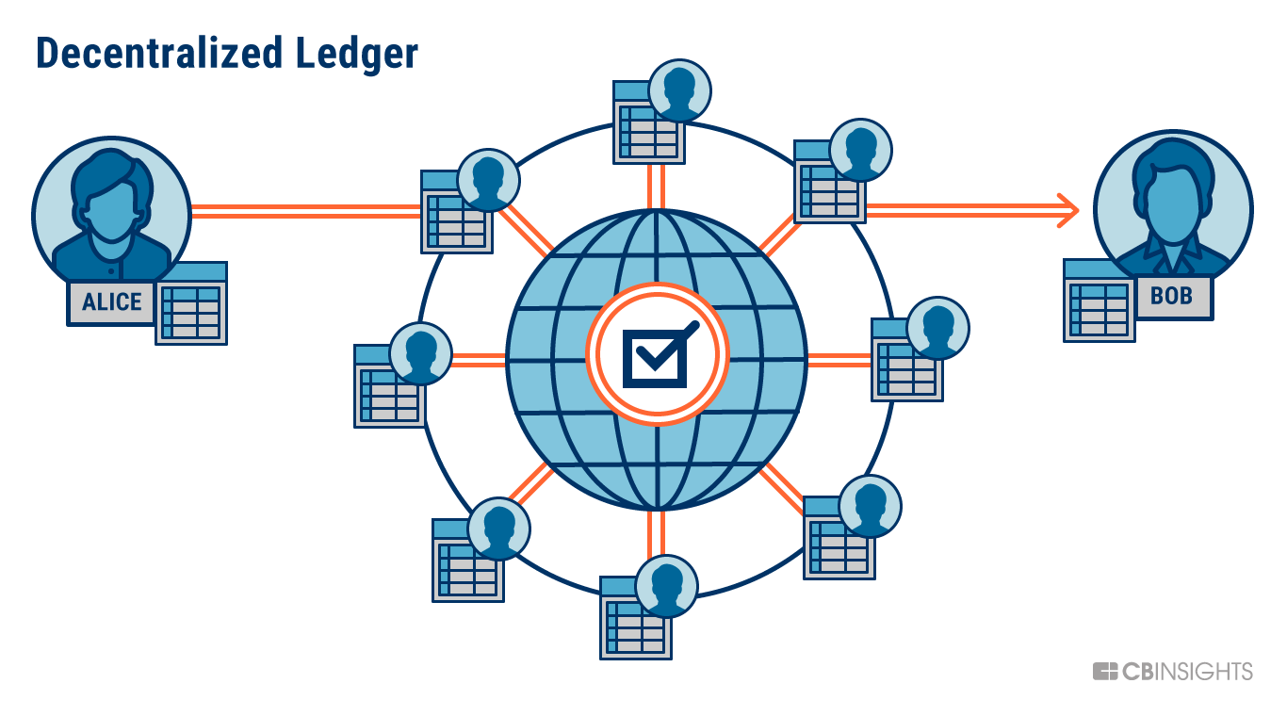
Background – Why Blockchain?
Traditional Centralized data management systems in healthcare have a couple of glaring limitations:
A single point of failure. This takes a large amount of money/resources to overcome.
Records are only available in network and the process of transferring information out of that network is confusing and tedious.
Distributed recordkeeping using blockchain infrastructure allows for both of these limitations to be overcome
Distributed ledger maintains a copy across each participating organization.
Network architecture facilitates direct information transactions between organizations.

Slide 3
Generalized Network Structure
Channel – allows for participating orgs to secretly communicate with each other.
Peer – a node that stores all transactions that occur on any channels its joined to.
Peers also participate in consensus (all parties agreeing to information in ledger being correct).
Order – responsible for ordering transactions, organizing them into “blocks”, then distributing those transaction blocks to all peers on a channel.
Certificate Authority (CA) – manages user certificate ID’s and permissions.
Client – application that interacts with blockchain network
Chaincode – code written in Go, Javascript, or Typescript that is deployed directly to a channel.

Slide 4
Pharmacy Management Structure
Organizations will be different Pharmacies
1
May result in multiple organizations within one hospital system.
Peers will be managed by Pharmacies themselves.
2
Hyperledger Fabric is a private, permissioned blockchain, so trust in administrators is assumed and new participants must be approved to join network.
Goal is to provide immutable records of incoming/outgoing pharmaceuticals for each pharmacy.
3
Pharmacist logs incoming stock from distributor or outgoing prescription to patient.
Other pharmacists acknowledge/approve transaction.
Record is stored in all ledgers connected to channel.

